Slide 1
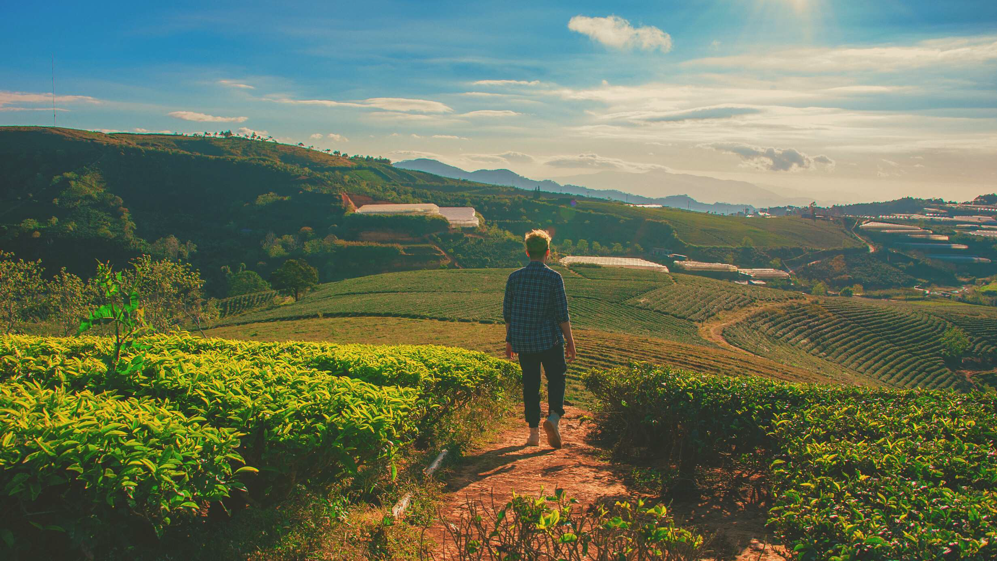
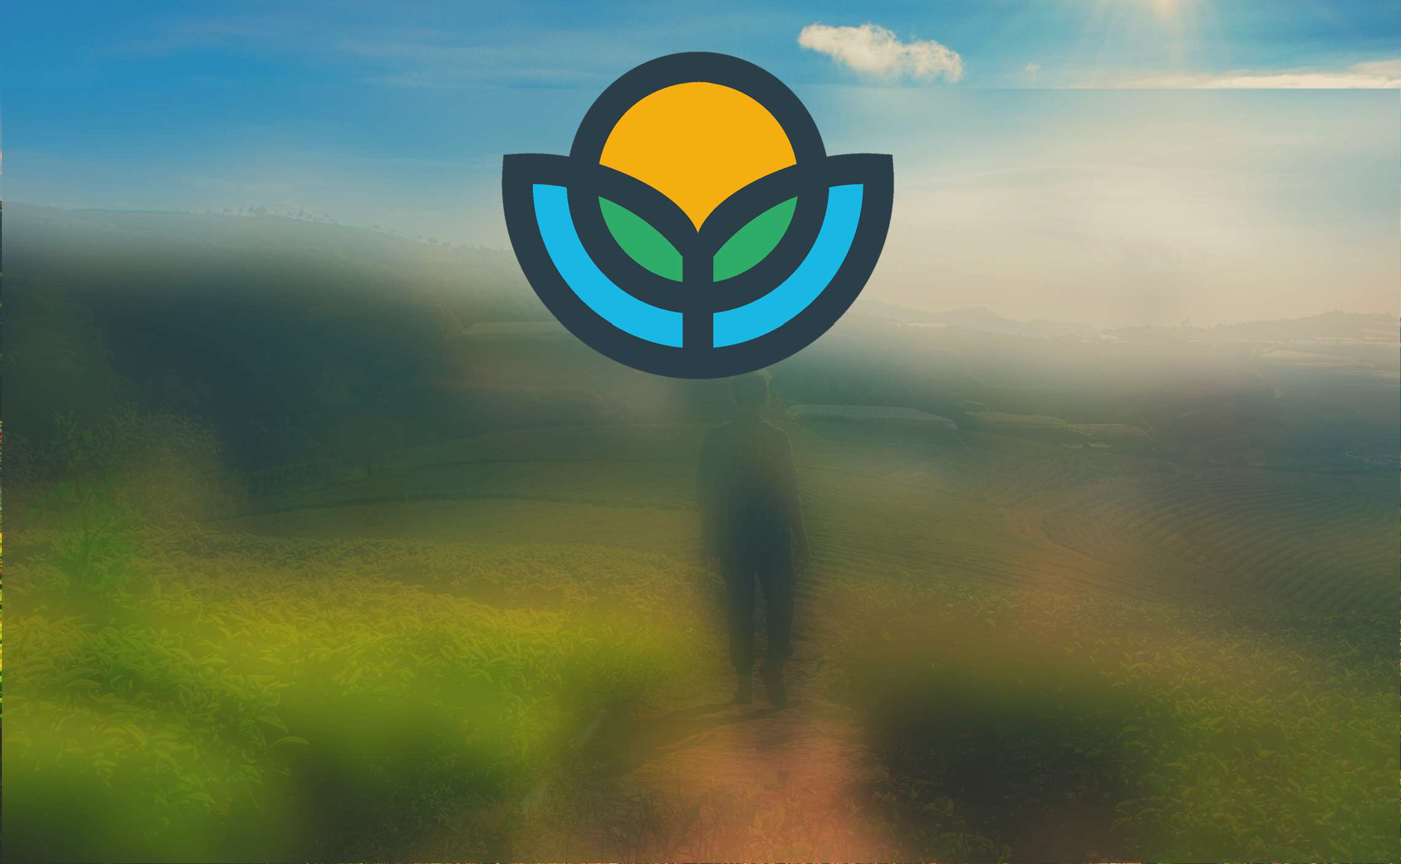
WORLDWIDE LOCAL
SALADS LTD
Co Number 12717055
Growing A Greener Future
Fully Sustainable Warehouse Growing
With our unique Wind Capture System
2024
1

Slide 2
WHO ARE WE?
We are innovators and think outside the box in every situation and we can find Solutions to most unexpected and even expected issues. Over the years we have found many solutions that improved growing techniques. We have found in the last 2 years how to save capital and Opex in a warehouse Vertical Farm. We have also transfered this to greenhouse growing. This is called COGS (cost of goods sold)
We have 1 patent granted on LED Lighting that saves Capital, Opex and Carbon Emmisions.
We also have 3 patents pending all of these are with the aim to make growing a profitable business once again. We have built a World Class management team that has worldwide growing and technical skills.
Our grow system has been proven to be the most efficient grow system for the last 20 Years in Commercial Hydroponic growing in 47 countries.We have the UK rights to this system and with our LED’s this makes it Unique. We have the exclusive distribution rights in the UK.
WorldWide Local Salads Wind Capture
We have the edge in Warehouse growing. Our unique Wind Capture System is going to revolutionise the Horticultural growing market. Unlike wind Turbines our Capture system is 100% safe and will not suffer from overheating as it is not subject to the elements. It will not cut out due to high winds as it runs at a constant 6.5 ms 24 hrs a day which means we produce the optimum energy 24 hrs a day 7 days a week 365 days a year.
THIS WILL CHANGE THE WAREHOUSE GROWING MARKET
Project CB -
7

Slide 3
KEY POINTS TO NOTE
In Horticulture the aim must be to lower cost. Unlike other industries we cannot control our sales price.
From saving Carbon emissions by the use of our patented LED System which saves 1,137,746.61 per Ha per year. (18,203,945.76 On Co2 emissions from Then we will also add a unique wind Capture system that is controlled by AI and runs the fans at the optimum wind speed needed for the optimum power production.
We have a unique LED Ligting system that reduces the amount needed by 50% This saves Capital, Opex BUT most of all Co2 emissions.
We also have a design for a wind Capture system air moving system that removes the need for AC Units all of this adds upto a massive saving in COGS (Cost Of Goods Sold)
We have spent 2 years developing these systems all to save energy to make growing food more cost effective for the grower.
We are SEIS & EIS compliant so investors can gain tax relief .
3
Project CB -

Slide 4
WorldWide Local Salads
Our unique Game Changer ( reducing Carbon Emissions)
Our main difference is ours is a wind capture device. This concept of wind power harnessing far outperforms traditional wind turbines of the same diameter and aerodynamics of the same characteristics under the same wind conditions. They deliver significantly higher output at significantly lower cost. The first notable feature is the elimination of the needed tower mounting system which is large and mechanically complex and the needed cranes to hoist them into place is a hallmark of the industry. They are also inefficient and a danger to Humans and wildlife.
One of the innovative features of the wind capture system is that it uses wind flow through an omnidirectional intake. As the air is looped the air also gets lighter so therefore increasing the flow which in turn lowers the energy needed.
•

Slide 5
WorldWide Local Salads
Our unique Game Changers (All help reduce Carbon Emissions)
WorldWide Local Salads Ltd have unique verified designs for patents on the following.
PAD & FAN
A unique wind turbine that fits on any greenhouse fan which will produce its own energy (Great for the Middle East where pad and fan greenhouse are more common. (Patent Pending)
CEA Warehouse Growing
A unit that allows us to use a Horizontal Wind Capture inside a warehouse or even a Greenhouse structure to produce energy. This design also allows us to use the air created as air movement inside for the Plants. This distributes air far more evenly and helps with Co2 & Humidity. (Patent Pending)
A unique Hydro plant which uses recirculated water again either warehouse or greenhouse operations. (Patent Pending)
A unique LED Lighting system that saves 50% in Capital and also 35% in Opex . This is a game changer for the operation of any grow system.
(Patent Granted)
•

Slide 6
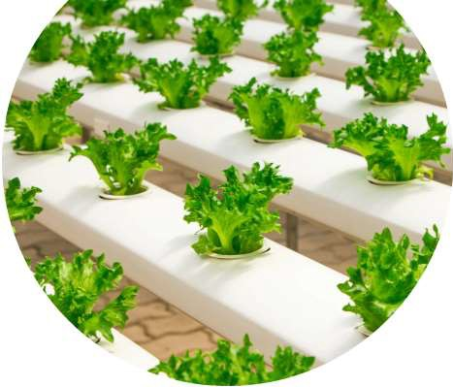
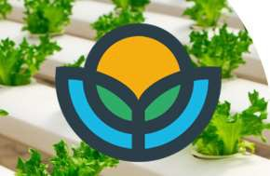
So how does our system work
We use a delivery system that can produce 4,500 m3 up to 8,000 m3 per hr and are very quiet so are under the decibel limit (But these will be inside soundproof and insulated room)
These fans will turn the turbine to produce the needed air flow to produce the Kw needed per hr. These can be run 24 hrs a day as they are commercial fans that we used in Bahrain, and they ran for 24 hrs a day in 60c heat and dust in a dessert terrain. SO, THEY ARE PROVEN.
The air will then pass through a tube and into the growing area as in the previous video. This air will then rise through the crops and into the roof space then it will be drawn through vents and start the cycle again.
This design is going to be a complete game changer for the industry. Reducing power cost and making smaller grows a lot more viable.
BOTH SOLAR AND WIND ARE LIMITED FOR HRS OF POWER PRODUCTION CAPABILITY.
This is 24 hr constant production and air movement.
12
Project CB -

Slide 7
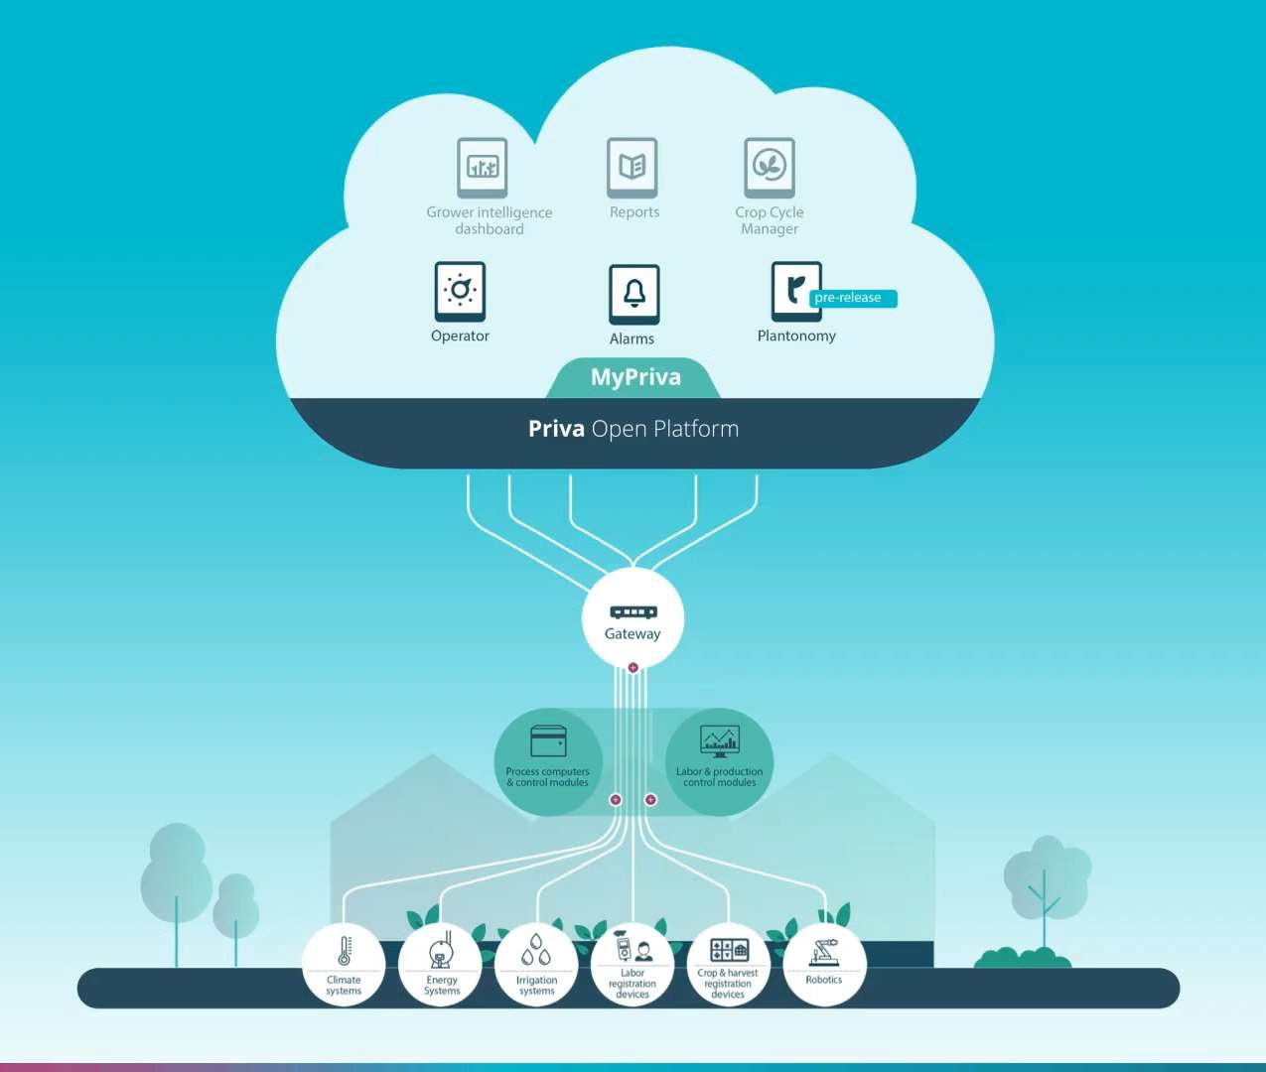
All of the control process is fully controllable
Modern greenhouse technology allows us to produce fresh, safe, and healthy food in a smart and sustainable way.
All-encompassing control over crop conditions, at any time, and from anywhere, is proving to optimise production, maximise yield, improve quality, and reduce the cost of resources like water, energy, and labour.
Next level of crop & Building control is here. This enables us to view, analyse, plan and automate at crop level. Anytime, anywhere.
So we can adjust any variable need to suit the need for the perfect climate inside the building
Everything controlled from one point even remotely. Named access so only named people can change settings.
Project CB - June 24
14

Slide 8
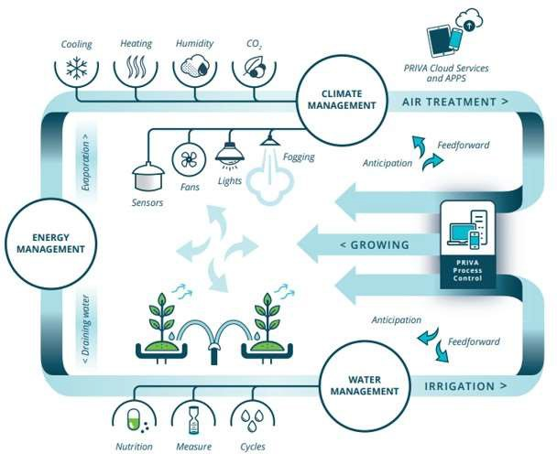
FULLY AUTOMATED PROCESS CONTROL
Water Management
optimise irrigation and nutrient delivery, ensuring crops receive the precise amount of water they need for optimal hydroponic growth. With cutting-edge technologies, we conserve water, reduce waste, and achieve sustainable productivity. With better air flow and consistent air flow we save even more Water
Climate Management
state-of-the-art climate control solutions provide precise monitoring and automated regulation
Of temperature, humidity, and CO2 levels, creating the perfect hydroponic growing environment for plants. MORE CONTROL OVER ALL OF THESE RESULT IN A BETTER END CROP.
Sensors
sensors provide real-time data on crucial environmental factors, plant health, and resource usage, enabling monitoring and adjustment of the greenhouse conditions proactively. By harnessing the power of IoT and sensor networks, we aim to revolutionise the way crops are grown.
Project CB
15

Slide 9
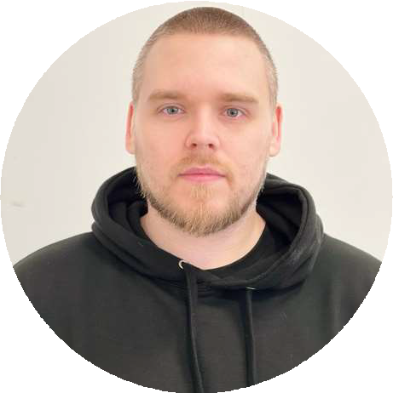
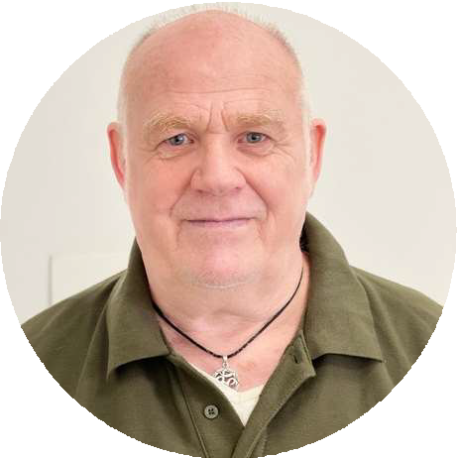
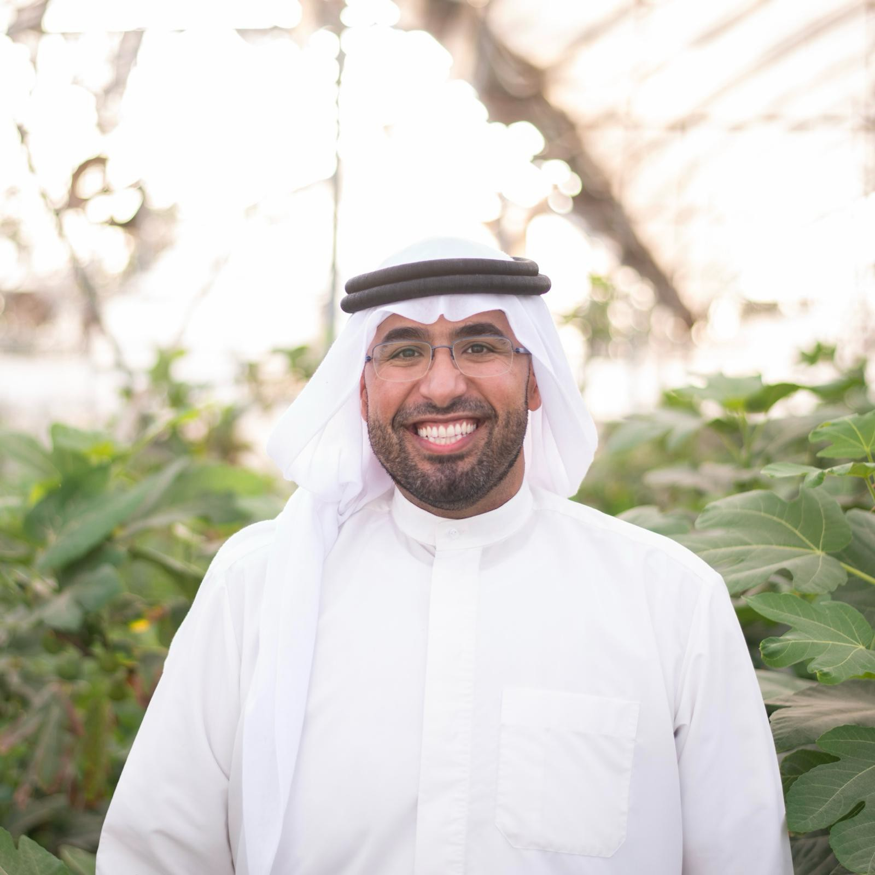
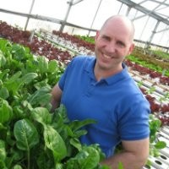
THE TEAM BEHIND US
Matt Dunling CEO & Co-Founder | Grahame COO & Co-Fou |  | Dunl nder |  | Sh Rashid Bin Khalifa ing Al Khalifa Chairman | Joe Swartz CTO .-Experienced CEA/Hydroponic Grower and
Matt Dunling, a passionate advocate for the | Grahame | Dunling | is | a | renowned | Master Farmer. Widely recognized as one of
revitalisation of Yorkshire's horticultural sector. With a deep understanding of the importance of preserving this rich heritage.
horticulturist and vertical farming pioneer with over 40 years of experience. From greenhouse to warehouse, he has supplied
Sh Rashid started life as a farmer back in 2009 when planning started for a greenhouse farm to be located near the TREE OF LIFE in the Kingdom of Bahrain. On 300,000m2 of Bahrain dessert sand a dream was born to build a farm to sustain life from the dessert to local people . Using Local staff trained up to grow quality and tasty salads.
Growing crops all the kingdom could be proud off and safe in the fact that NO chemical was to be sprayed onto the crops and a new method of IPM control was introduced.. Sh Rashid was the person who brought all of this to Bahrain and he employed Grahame Dunling to turn things around
the leading consultants to all Controlled Environment Agricultural industries with a long and proven track record of success - from greenhouse hydroponic farms to indoor production. A well-know problem solver and trainer to commercial growers around the world. Leverages high level relationships with leading ancillary technology providers such environmental control systems, IoT and blockchain technologies, alternative energies, produce packaging, and horticultural growing supplies to provide growers with "real world" solutions that provide maximum horticultural quality and economic return. 36 years as a successful commercial hydroponic vegetable and herb grower. (Over 55,000 hours of CEA experance
Matt is dedicated to restoring the region's former glory in the world of horticulture. By promoting sustainable practices and inspiring young people to join the trade, Matt hopes to ensure the longevity of the industry and pave the way for future generations to thrive.
top supermarkets, Michelin-starred
restaurants, and chefs across the UK and Dubai.
A serial entrepreneur, Grahame has built
multiple cutting-edge vertical farms globally. In 2008 Grahame constructed the first automated vertical farm in the UK, followed by similar projects in Kentucky, Hong Kong, and Bahrain, where he built the first vertical farm for the Royal Family of Bahrain. As CEO of UNS Farms, he increased the company's turnover from AED25,000 to AED400,000 per month.
Today, Grahame continues to innovate and share his expertise, shaping the future of sustainable agriculture.
Matt's passion for sustainability and technological advancement led him to develop the patent pending WWLS Lighting System, a game-changing solution that significantly reduces energy consumption compared to other Vertical Farms.
Project CB -
“The people who are crazy enough to think they can change the world are the ones who do.” Steve Jobs

Slide 10
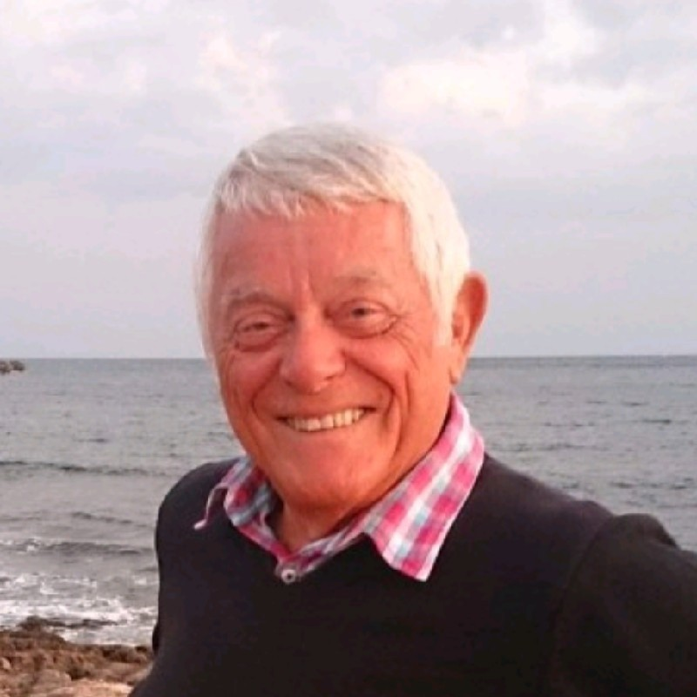
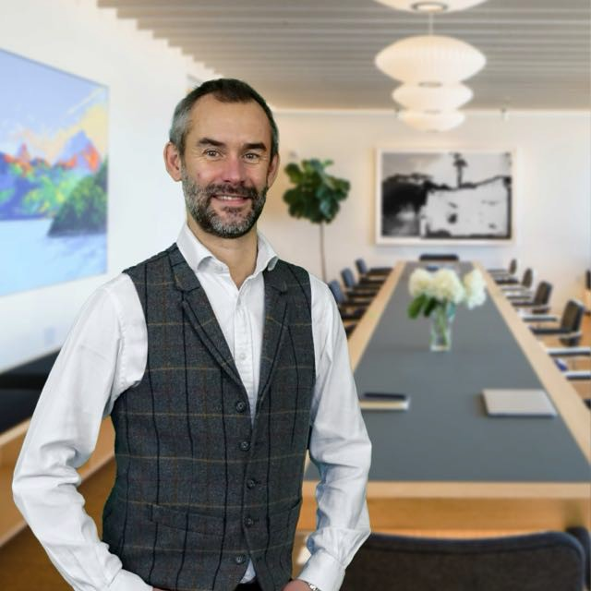
THE TEAM BEHIND US
Tradition Meets Future
Business Advisor
CFO
Our team is used to thinking outside the box and doing things that people say cannot be done . We were the first to do Vertical Growing in 2008 in the UK. We said then about doing it in countries of high weather conditions. In 2012 we did this in Bahrain much to everyone's surprise.
Now with our wind capture system we can actually make Warehouse growing viable as we eliminate the need for AC Units and separate fans in the system.
Once again WorldWide Local Salads are breaking the tradition of how modern growing works.
Yet we grow crops as our grandparents used to. This is to say we grow for flavour, looks & taste and of course Shelf life.
Martyn Rose
•
Matt Wilson
My cousin (a US TV entertainer), funded my 1st UKco formed with a school friend (Mildenhall Rose Designs Ltd). We sold UK handmade products worldwide with 2K clients after 2 yrs! My 3rd start in London was as MD for what became leading creative agency (Hewson, Rose & Nicoli part of Cannon st investments & Slater Walker (another Grammar school boy). I services in 17 countries. I returned to London in 2005 having been involved in NPD, Licensing, Patenting, Retailing, Consulting, Project Management (c40+ main projects completed to EMA award winner Nov 2019). Startup Funds raised were £100M (£20M indirectly). I am now involved in Renewable Energy Devts, Software Services & Project Management in new markets. I work with Energy & Financial groups, & new Disruptive Technologies.
An experienced finance leader with time served in the manufacturing, distribution and FMCG sectors, including multiple transactions and external funding activities.
I am a business focused financial leader with the ability to communicate to all levels in a complex organisation and drive change. I aim to make a difference in every business I get involved with.
I spend time visiting, discussing and
fully understanding your business. I try to install my enthusiasm and energy to the team. This enables positive and collaborative relationships - with the aim to bounce ideas off each other to map the correct strategic path forward and to drive those parts of the businesses I get involved with.
I aim to be one of the 'Go to guys’ for
those I work with or on, for strategic thought and accounting experience.
•
8
“The people who are crazy enough to think they can change the world are the ones who do.” Steve Jobs

Slide 11
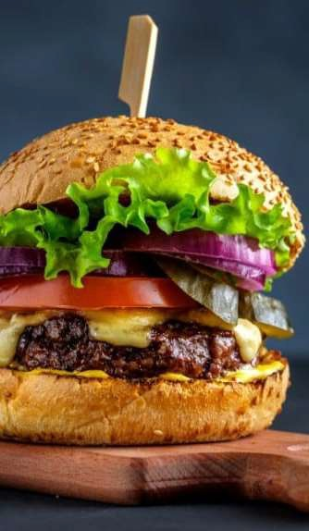
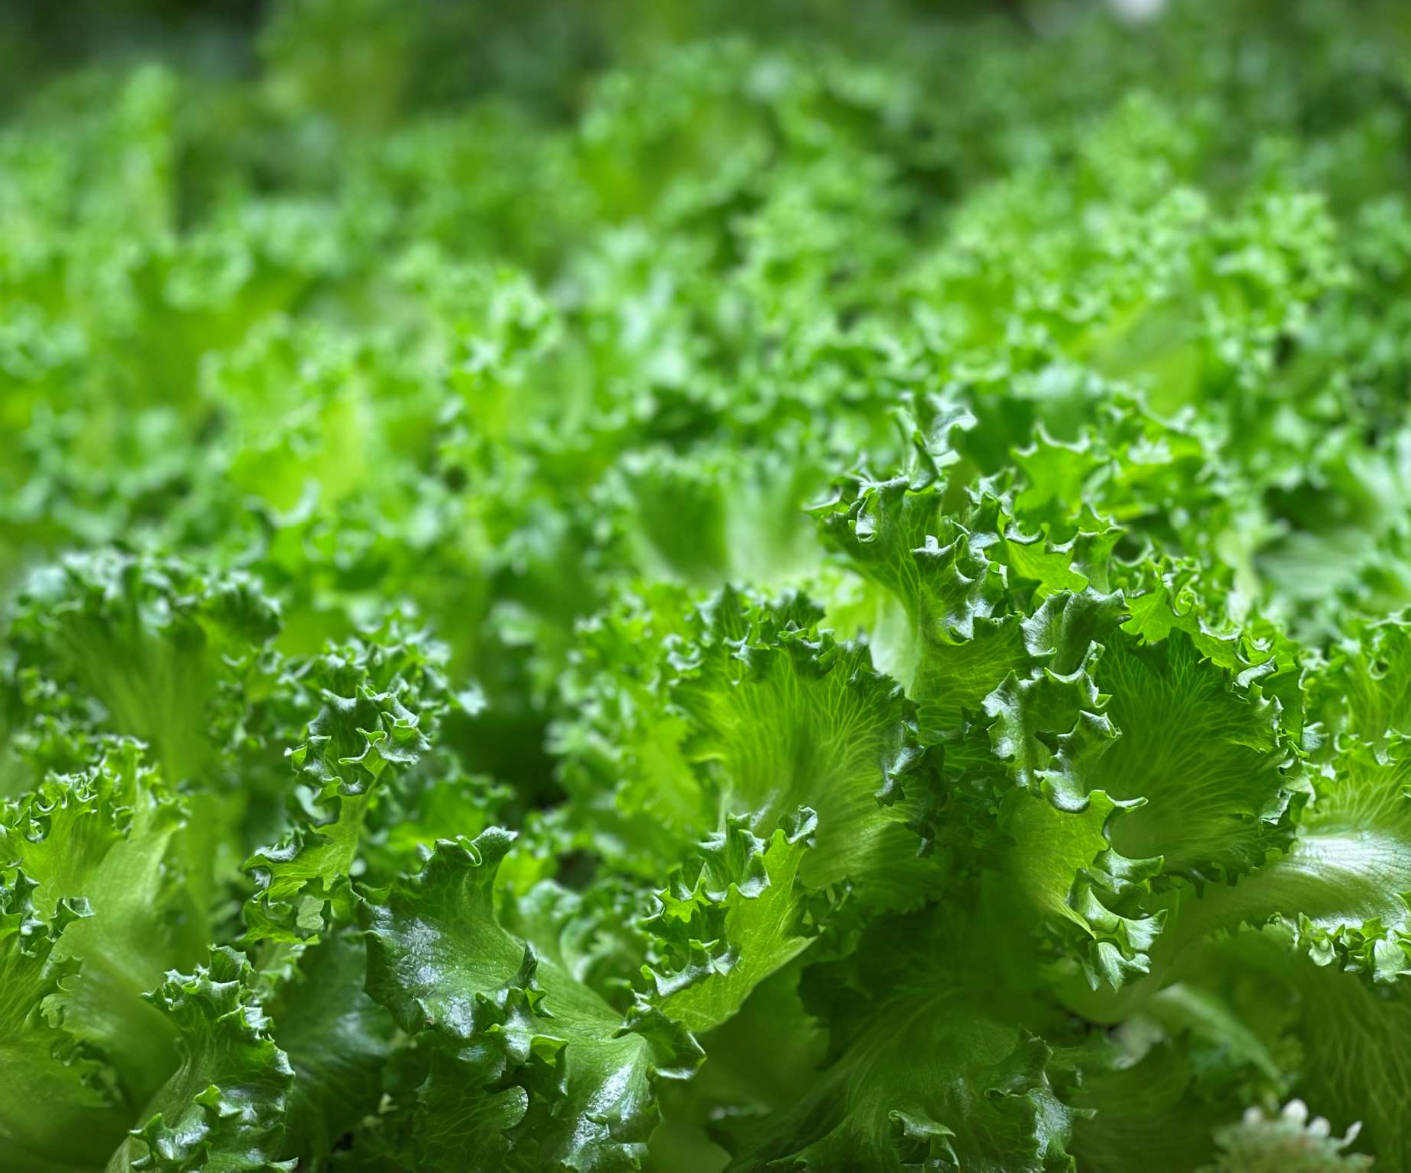
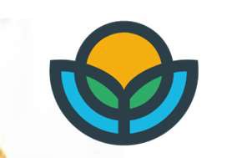
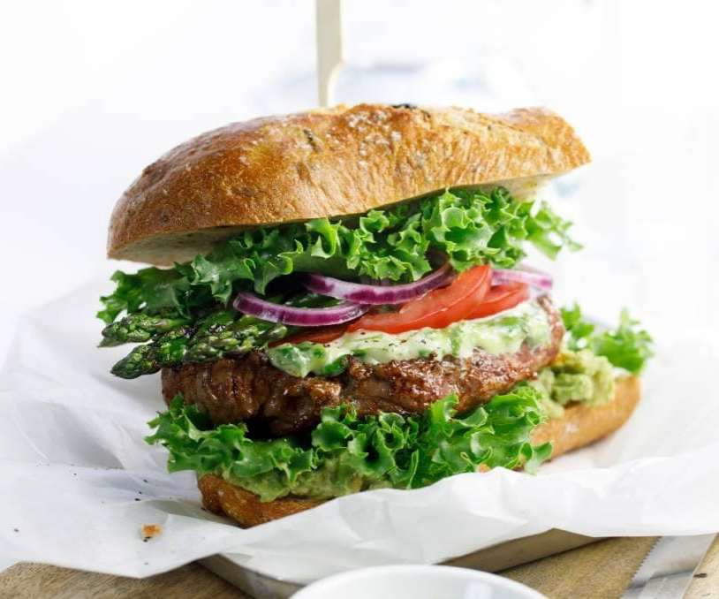
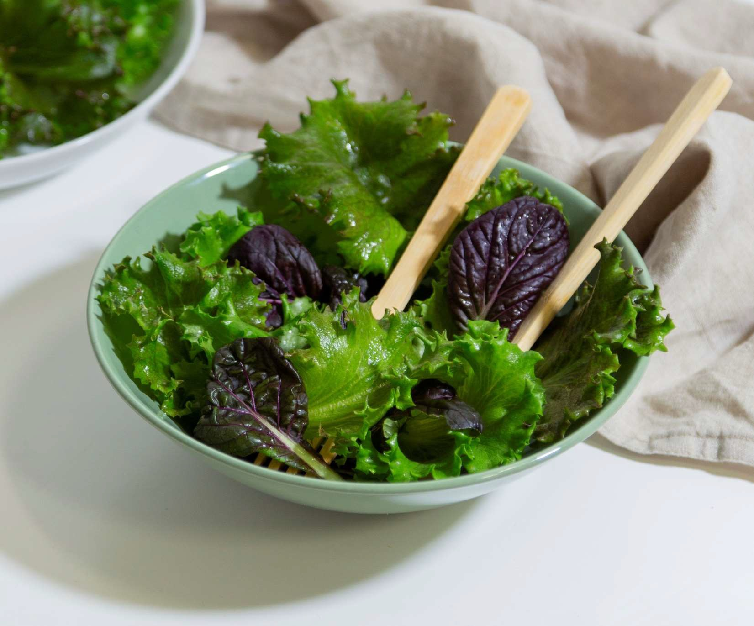
WHY “CRUNCHBERG”?
Crunchberg is a new unique lettuce with a satisfyingly crunchy, juicy bite. 100% taste, 0% chemicals.
With thicker structure, the leaves, combined with their attractively frilled edges, makes this variety particularly interesting for the foodservice sector because the leaves can withstand heat better than any other lettuce
Ideal for use in burgers and sandwiches and also very suitable for Asian hotpots and stir-fried dishes.
32

